Slide 1


Planning and Controlling Relays for Older Competitors.

Slide 2
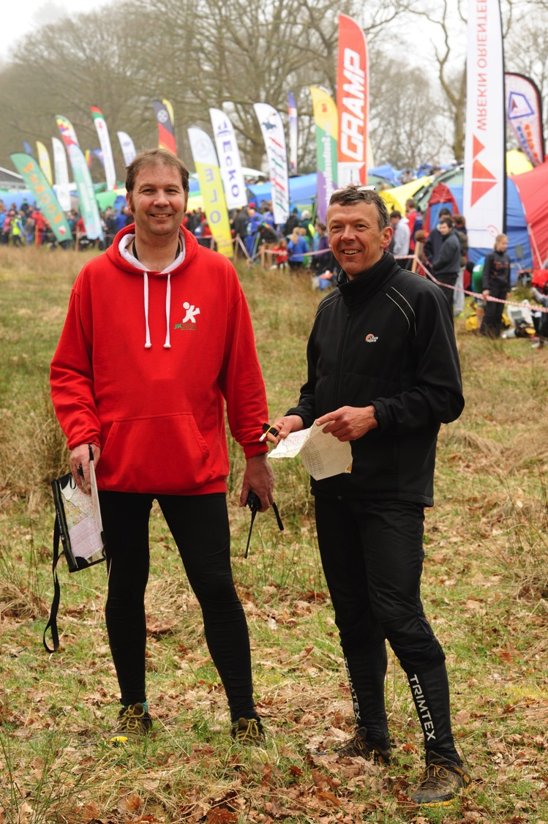
Allan Williams
WCH
Controller
Quentin harding
SROC
Planner

Slide 3
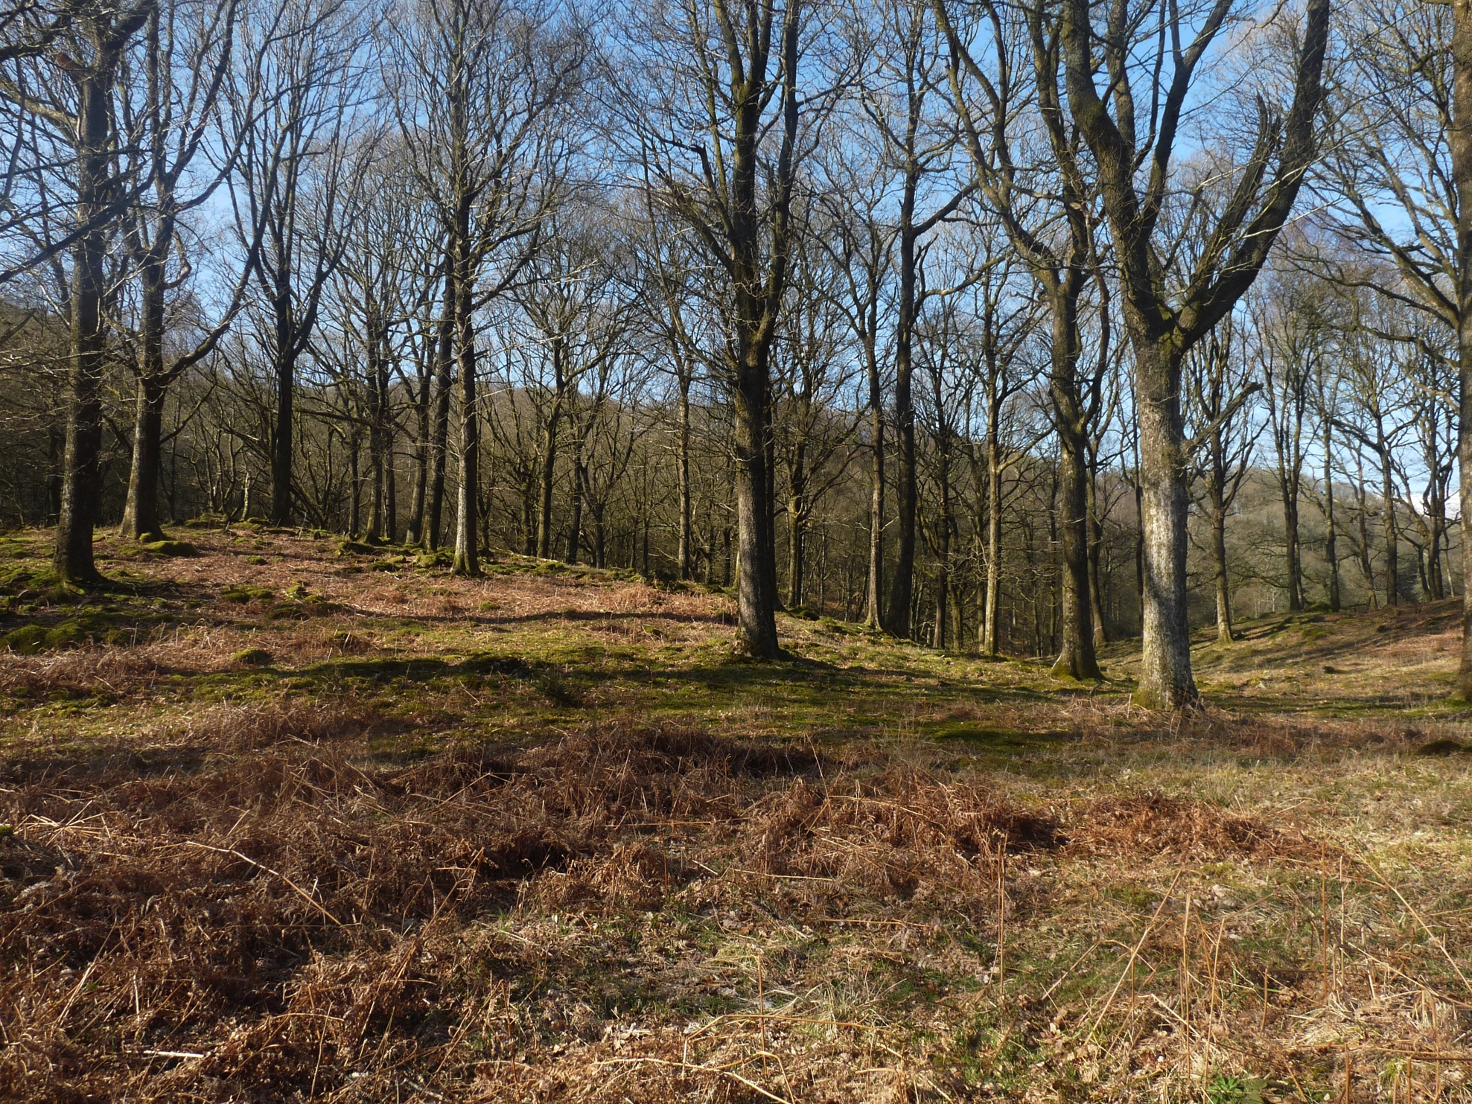
Nice Area (Described by one member of Chasers as “sexy”)

Slide 4
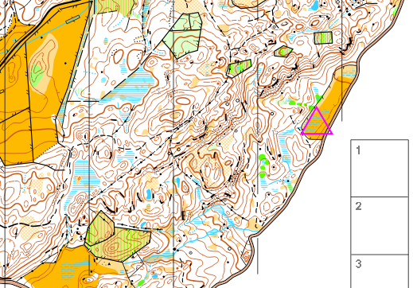
You can’t avoid climb by walking to the start. Relays can only have 1 start.
But are long walks to a start a problem for older runners ?

Slide 5
Low assembly area Therefore everyone has to climb
Everyone would have to
Go up to the ridge and back down.

Slide 6
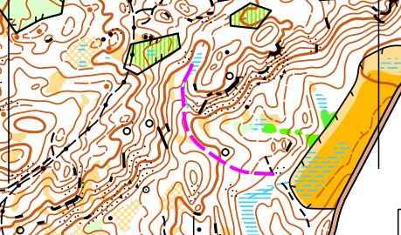
“ After spending some time in the area I decided the safest descent for all the competitors would be the one that was used. “ Quentin.
Not too steep, not rocky.

Slide 7
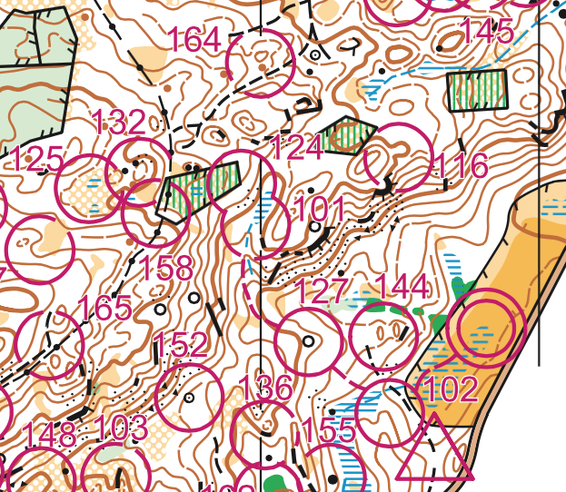
Serious Fall here
Some people used this route

Slide 8
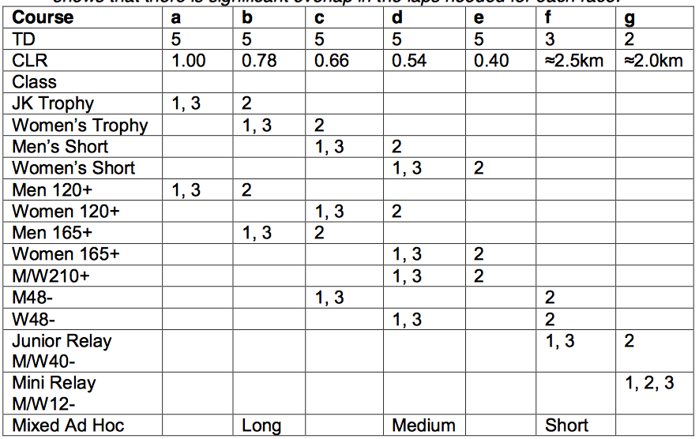
Veterans can get everywhere.
e.g 35+35+50

Slide 9
From the Planner
“While I did not envisage my main customer of AdHoc Leg2 would be older veterans, this age group was very much on my mind for the MW210+ for which the average age per team is 70. The guidelines say that this course should run the same as the Women’s Short, W165+ and the W48- and it was planned to provide a technical challenge without adding any extra climb, indeed the climb for the second leg was estimated at being the same as this orange course.”

Slide 10
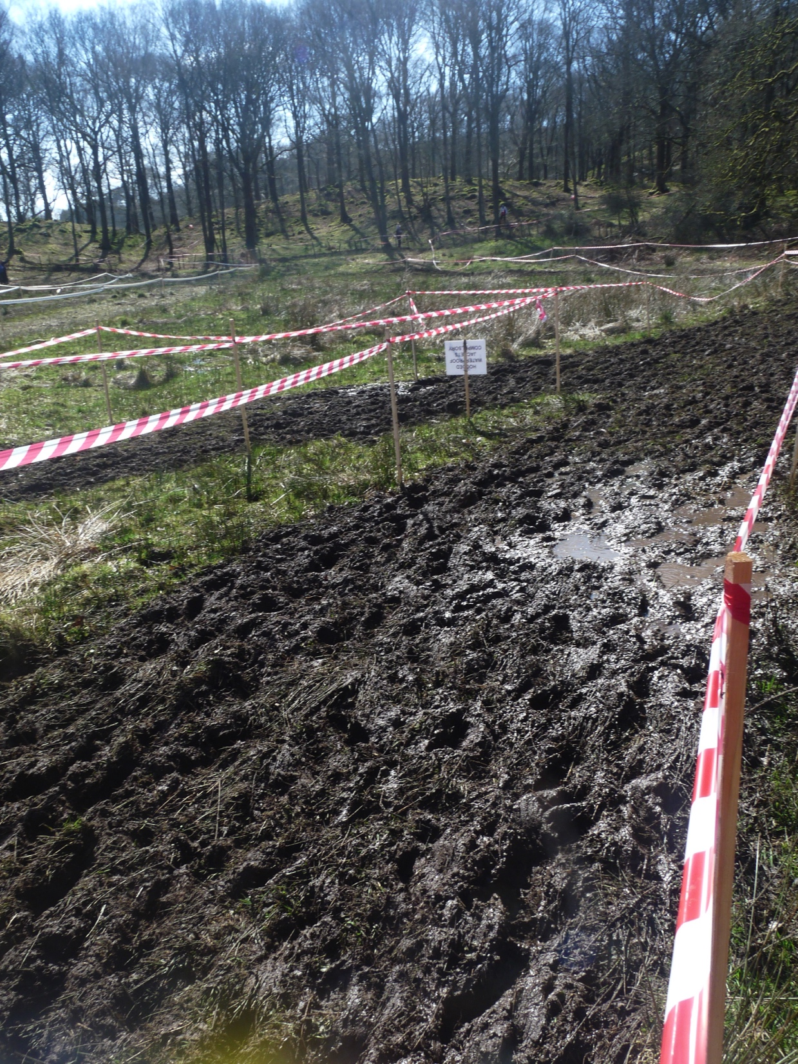
Conditions can change.

Slide 11
Where was my focus as controller ?
Safe Junior courses in a challenging area.
Getting TD right for AdHoc (With Gaffling and fixed leg order)
Avoiding dangers, especially trips on wires and fence supports.
Removing branches from main downhill run in.
Getting the right map to the right runner.
Not specific to older competitors but all useful.

Slide 12
Thank you.

